Slide 1
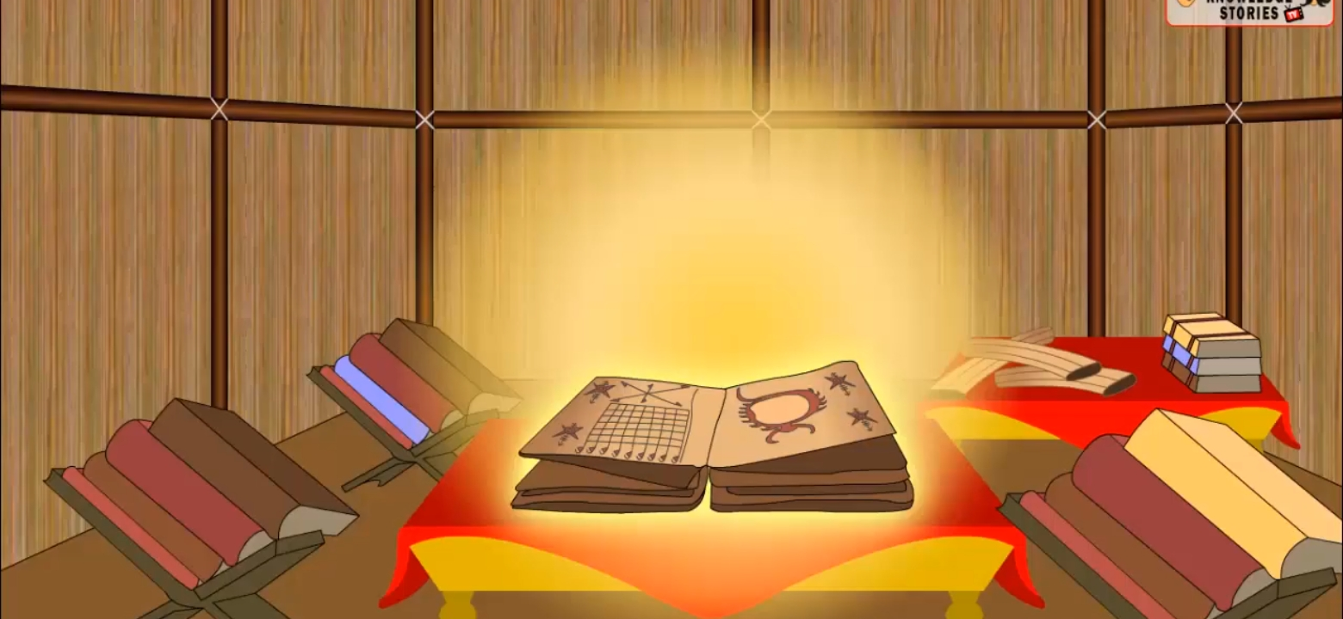
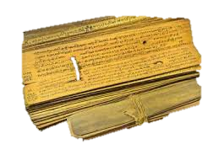


3S - Scripture
Discover
Manual Of Life
Access Truth Beyond Defects
Speaker
Mr. K Loknath Reddy
👉B. Tech from SV University ,Tirupati
👉Working as Software Engineer in INFOSYS Technology, Chennai
👉Mentor for IIT Tirupati Students
DATE:- 10th Dec
TIME- 09:30 AM, Sunday.

